Slide 1
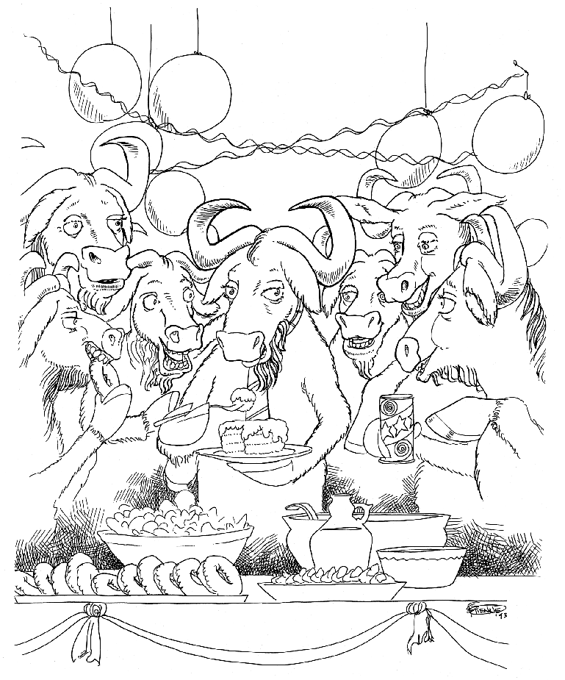
the brave GNU world
Notes:
Note Page by Willem van der Plaat

Slide 2






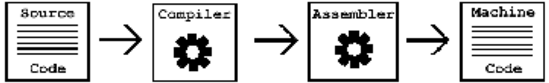









The Code

Slide 3
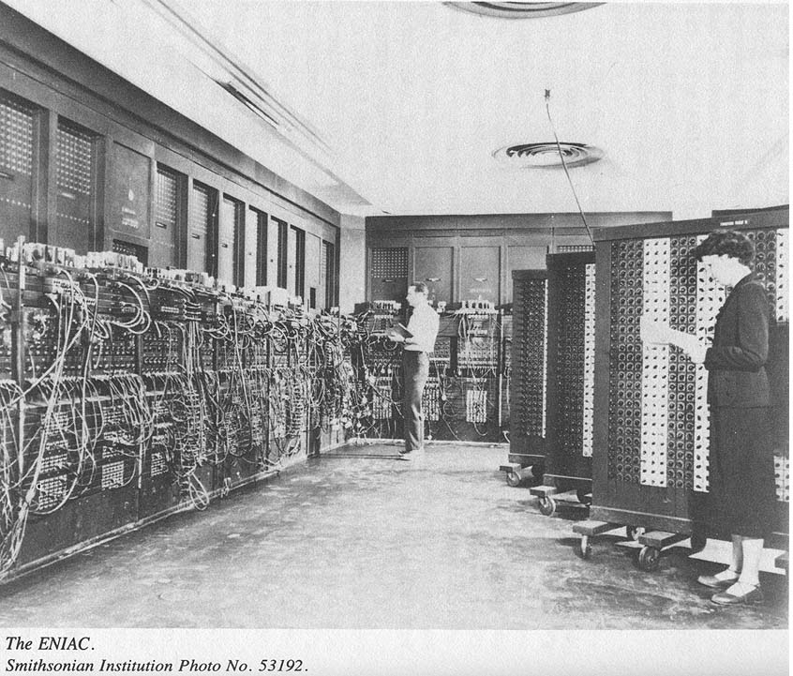
In the begining...

Slide 4


Heros of Computer Revolution

Slide 5
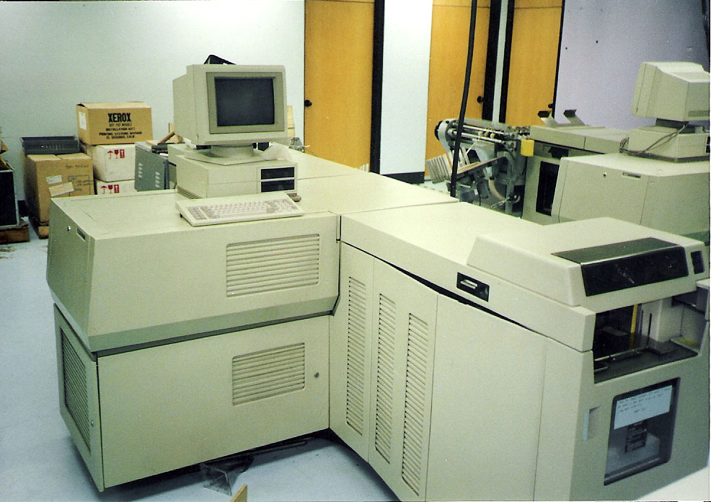
Tale of a printer

Slide 6

Copyright

Slide 7
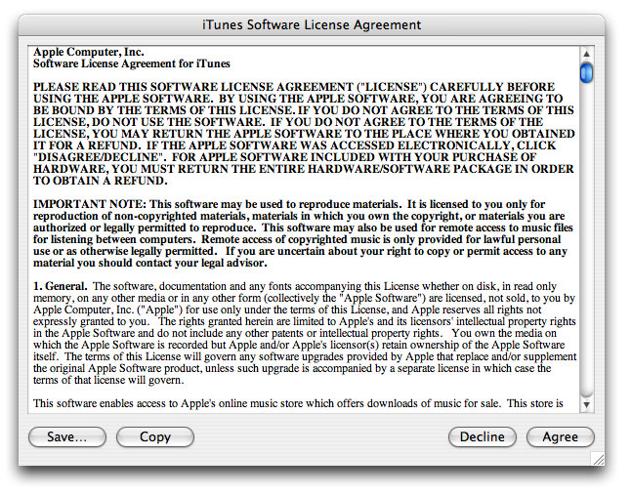
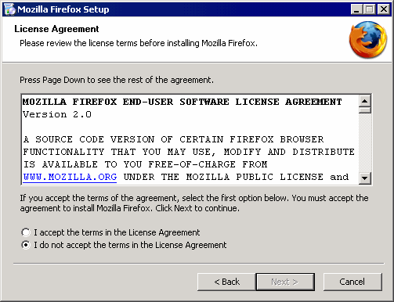
Software License

Slide 8
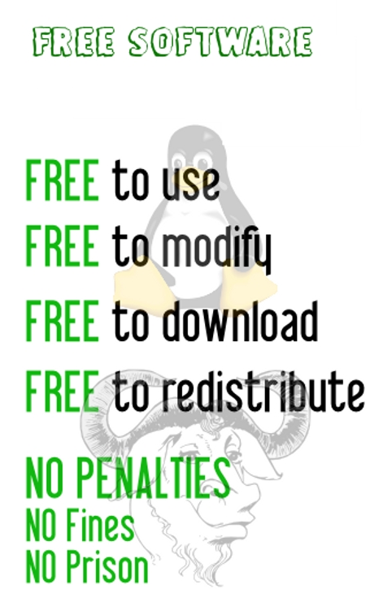
Free Software

Slide 9
Free Software Definition
Free software is a matter of the users' freedom to run, copy, distribute, study, change and improve the software. More precisely, it means that the program's users have the four essential freedoms:
The freedom to run the program, for any purpose (freedom 0).
The freedom to study how the program works, and change it to make it do what you wish (freedom 1). Access to the source code is a precondition for this.
The freedom to redistribute copies so you can help your neighbor (freedom 2).
The freedom to distribute copies of your modified versions to others (freedom 3). By doing this you can give the whole community a chance to benefit from your changes. Access to the source code is a precondition for this.

Slide 10
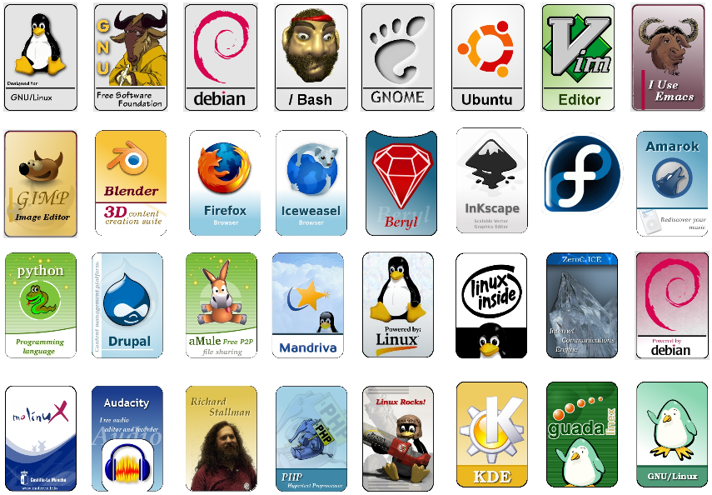
more

Slide 11
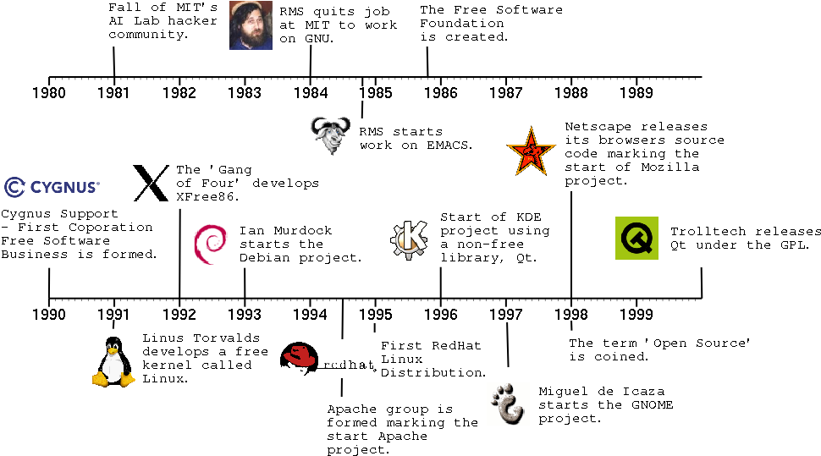
History

Slide 12






Who are using it?
Governments : NRCFOSS, FOSSEE, Universities, Keltorn – IGSG http://www.osor.eu/ etc. etc.
Schools : IT@School Project in Kerala
Companies: Intel, Google, Nokia, Sun/Oracle Facebook, Yahoo, IBM, Flipkart etc..
They are not just using Free Software but contributing too...

Slide 13
An interview with Bill Gates
Interviewer:
"Is studying computer science the best way to prepare to be a programmer?"
Bill Gates:
"No, the best way to prepare is to write programs, and to study great programs that other people have written. In my case, I went to the garbage cans at the Computer Science Center and I fished out listings of their operating system."
http://programmersatwork.wordpress.com/bill-gates-1986/
"Programmers at Work" by Microsoft Press

Slide 14


So, why, why do people and companies develop free software?
Programming is Fun
Google, Kerala Govt. mozilla foundation, gnome foundation etc sponsor students to build Free Software
GSoC, FOSTER etc...
Free testing, peer reviewing, debugging, patches etc.. (from the community)
Submit patches and modules – you get projects...

Slide 15
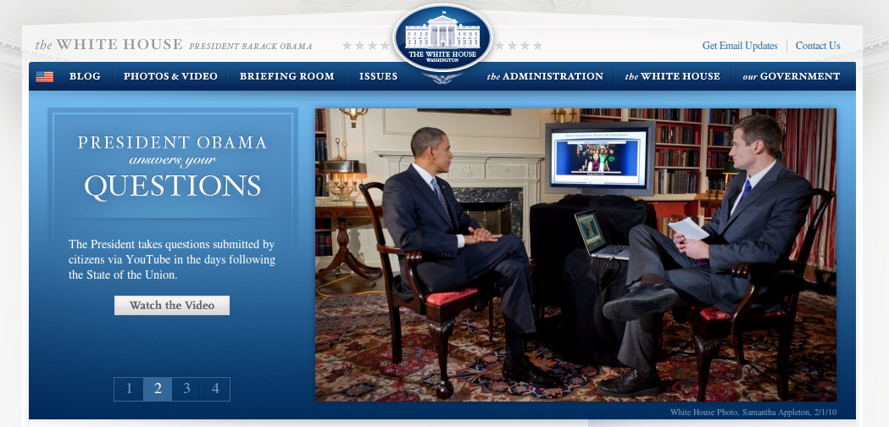
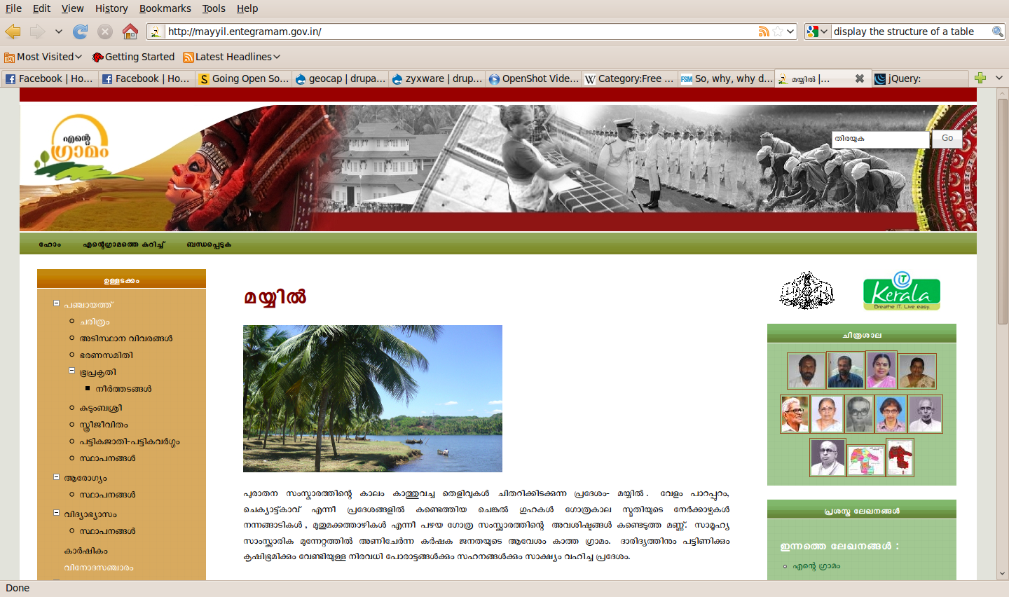
Drupal – A case study
One of the best content management framework available today
Started by Dries as a personal project to communicate with friends...
A very active community
Tons of modules
It is used by
  http://whitehouse.gov
  http://mayyil.entegramam.gov.in/
  http://www.spreadfirefox.com/
  http://jaanlo.com/
  etc...
It is highly secure
It is highly customizable

Slide 16
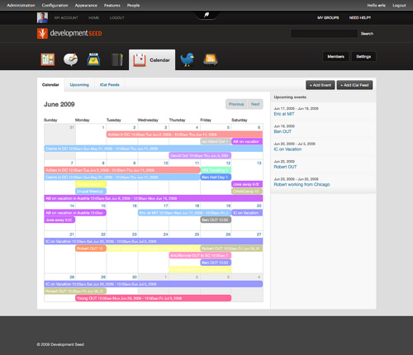

Projects/Companies based on Drupal
Acquia – A company that provide custom solution over drupal
OpenAtrium – Intranet portal
OpenPublish – online publishers portal based on drupal
CivicSpace – Community websites
Tattler - finds and aggregates content from the Web on selected topics
Pressflow – Optimized drupal for scalability
and more...

Slide 17
In Kerala
Zyxware.com
  Projects
    Search 404 (48 commits)
    Comment Subscribe (45 commits)
    Conference (24 commits)
    Ranged Search for Faceted Search (17 commits)
    CCAvenue Payment Gateway for Ubercart (8 commits)
  Total: 142 commits
The first free software module available to integrate a shopping cart and ccavenue in drupal

Slide 18

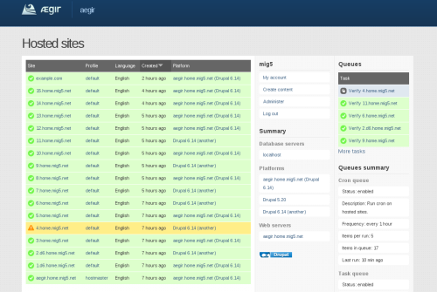
Scalability
Aegir – with this set of modules you can maintain any number of drupal websites with your fingertip
http://entegramam.gov.in Is the best example
  1000 websites
  1 click deployment
  1 click backup
  1 click up-gradation
  And lots more..

Slide 19
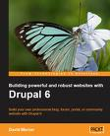







Documentation
http://drupal.org

Slide 20
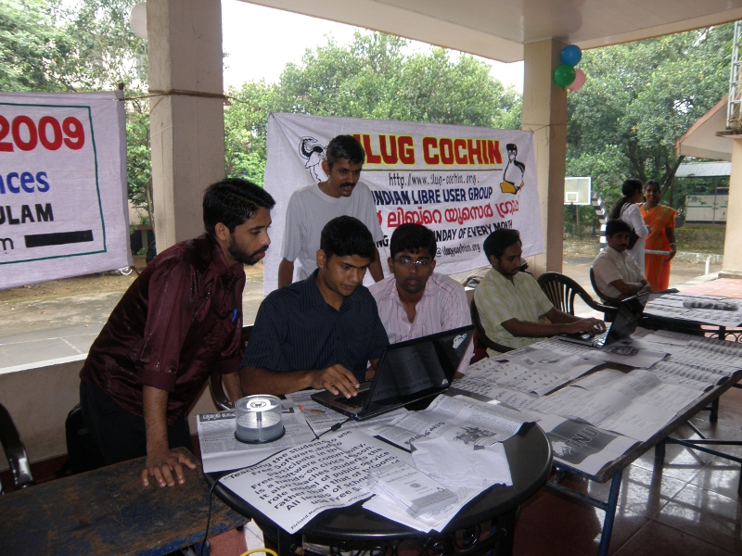
Free Software Communities in Kerala
Ilug-Cochin – Mailing list http://www.ilug-cochin.org/mailing-list/
FSUG-Trivandrum – Mailing list http://groups.google.com/group/ilug-tvm

Slide 21
Resources
http://fsf.org
http://gnu.org
http://debian.org
http://ubuntu.com
http://ubuntuguide.org
http://openoffice.org

Slide 22







Distributions
Application Programs
GUI
GNU Tools
Kernel

Slide 23
Thanks...
questions??
vimal.joseph@zyxware.com
www.zyxware.com

